Slide 1
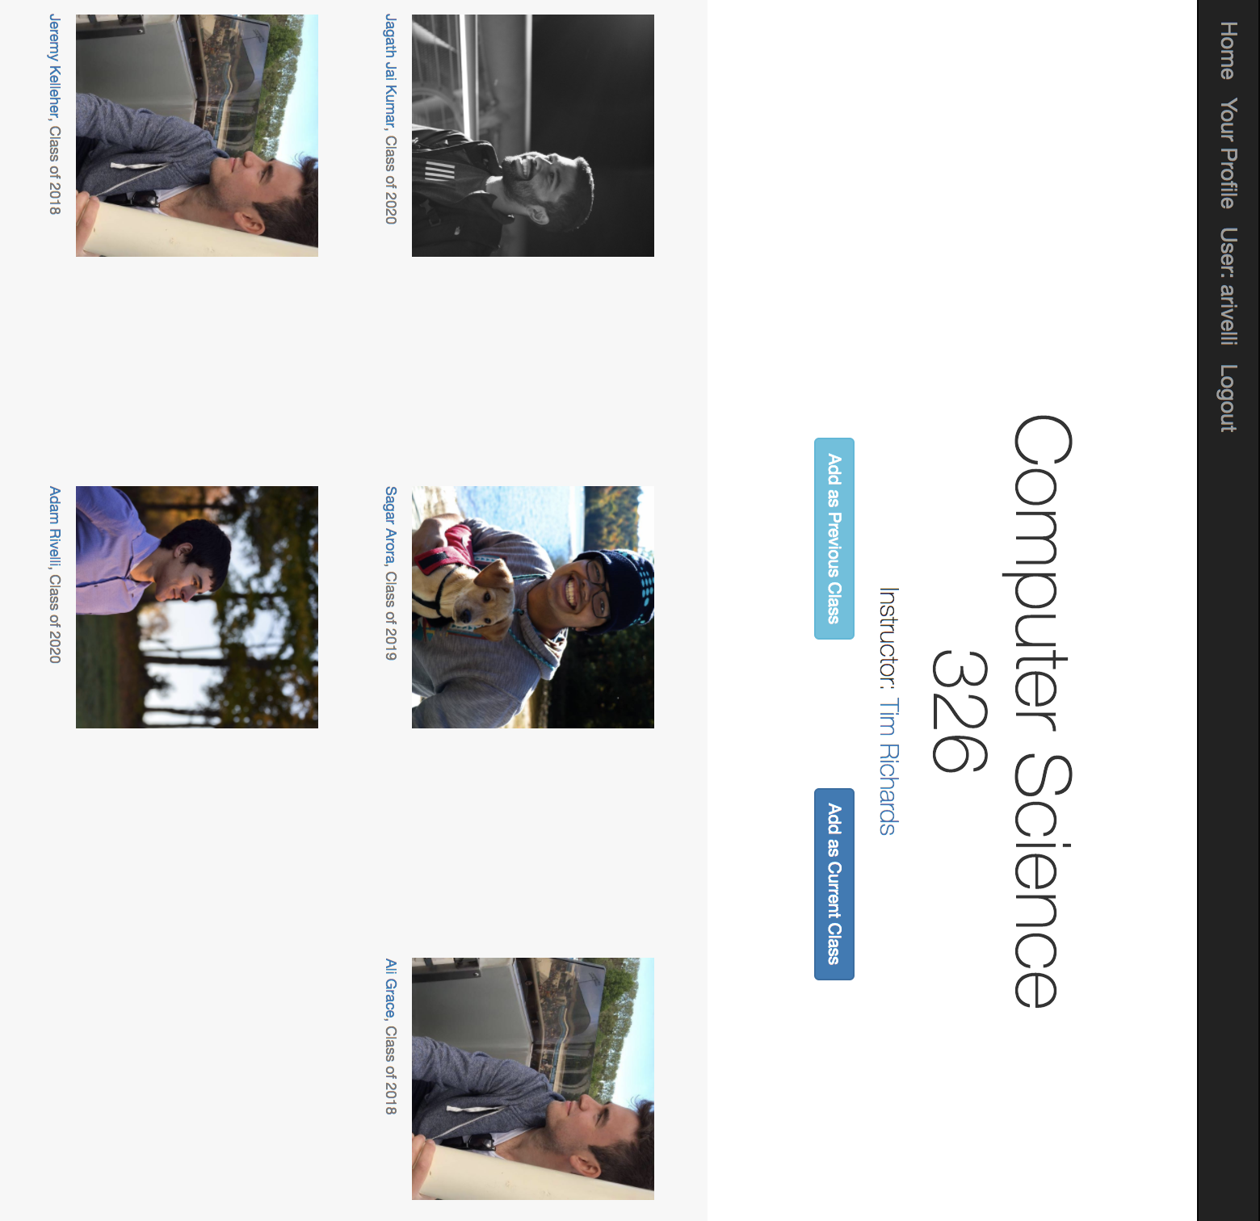
Team WIP - Tibl

